Slide 1
Farm animals
English vocabulary

Slide 2
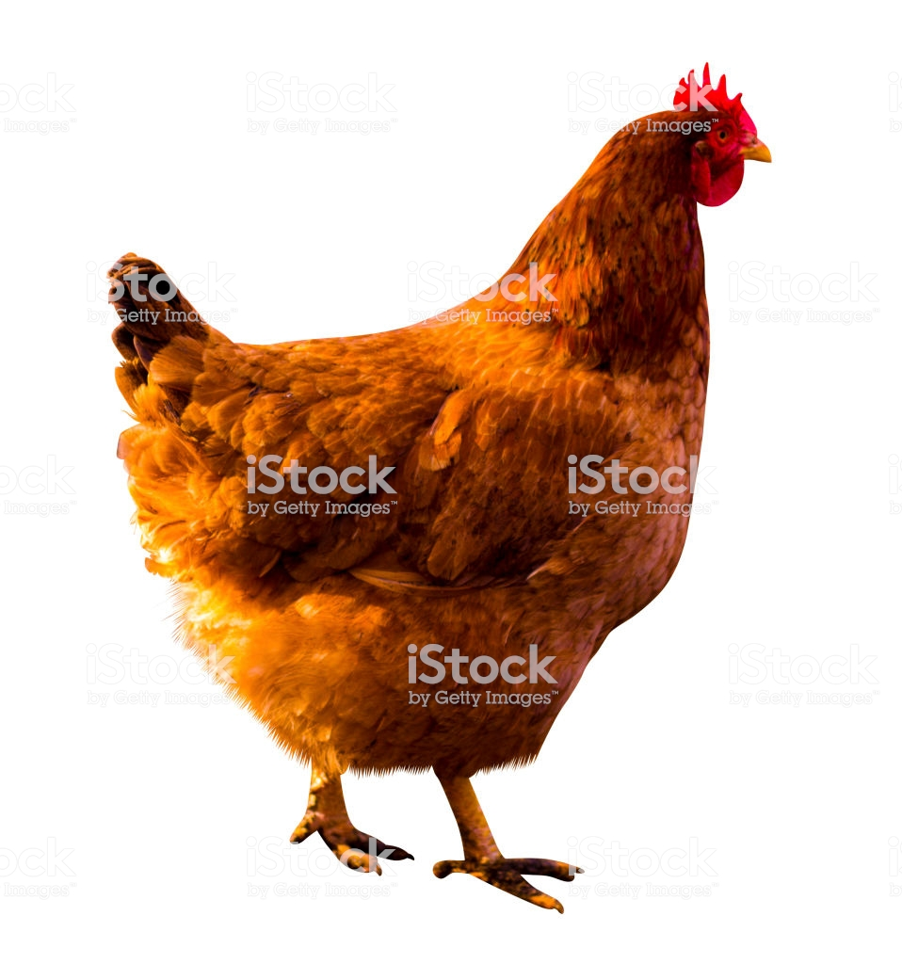
This is a hen.
hen

Slide 3
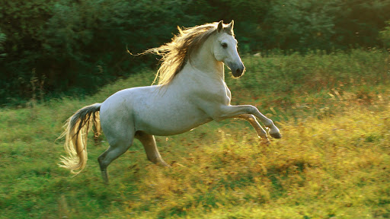
This is a horse.
horse
eskipaper.com/free-horse-wallpaper

Slide 4
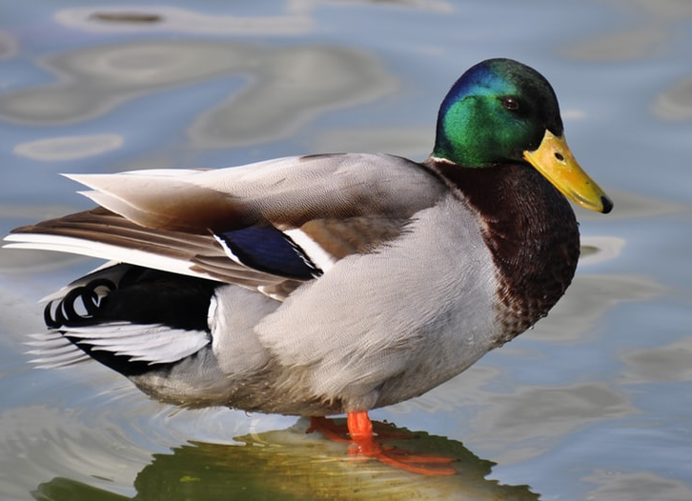
This is a duck.
duck
https://unsplash.com/s/photos/duck

Slide 5
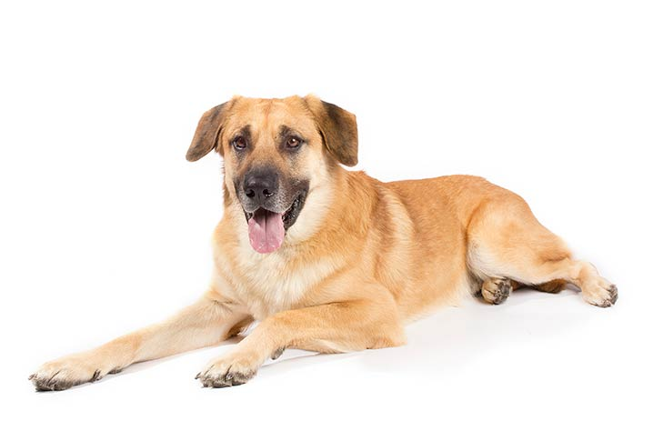
This is a dog.
dog
www.akc.org/dog-breeds/chinook/

Slide 6
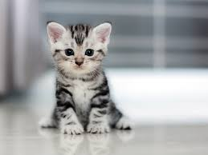
This is a cat.
cat
www.rd.com/advice/pets/cutest-cat-breeds/

Slide 7
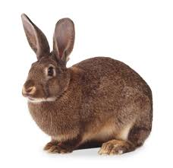
This is a rabbit.
rabbit
dkfindout.com/us/animals-and-nature/rabbits-and-hares/

Slide 8
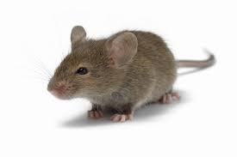
This is a mouse.
mouse
https://www.tes.com/lessons/G3kXlMvn-8DNDA/mice-preparation-for-the-mouse-and-the-motorcycle

Slide 9
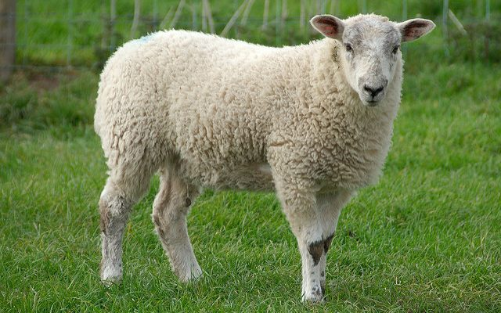
This is a sheep.
sheep
https://www.morningagclips.com/got-sheep/

Slide 10
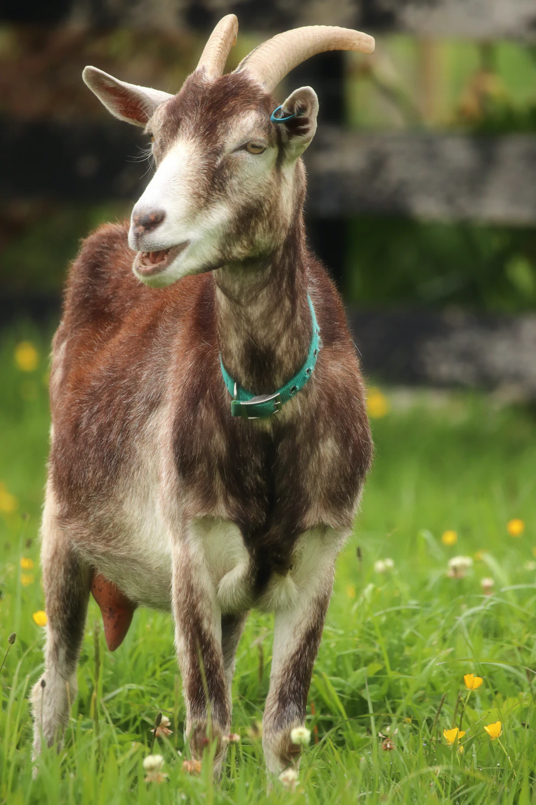
This is a goat.
goat
unsplash.com/photos/5UWRb6vNfxo

