Slide 1
Telling the time
D Class

Slide 2
-What’s the time?
-It’s one o’clock.

Slide 3
- What’s the time?
- It’s three o’clock.

Slide 4
-What’s the time?
-It’s half past one.
or
-It’s one thirty.

Slide 5
What’s the time?
- It’s half past four.
or
- It’s four thirty.

Slide 6
- What’s the time?
- It’s a quarter to eight.

Slide 7
What’s the time?
It’s a quarter past two.

Slide 8
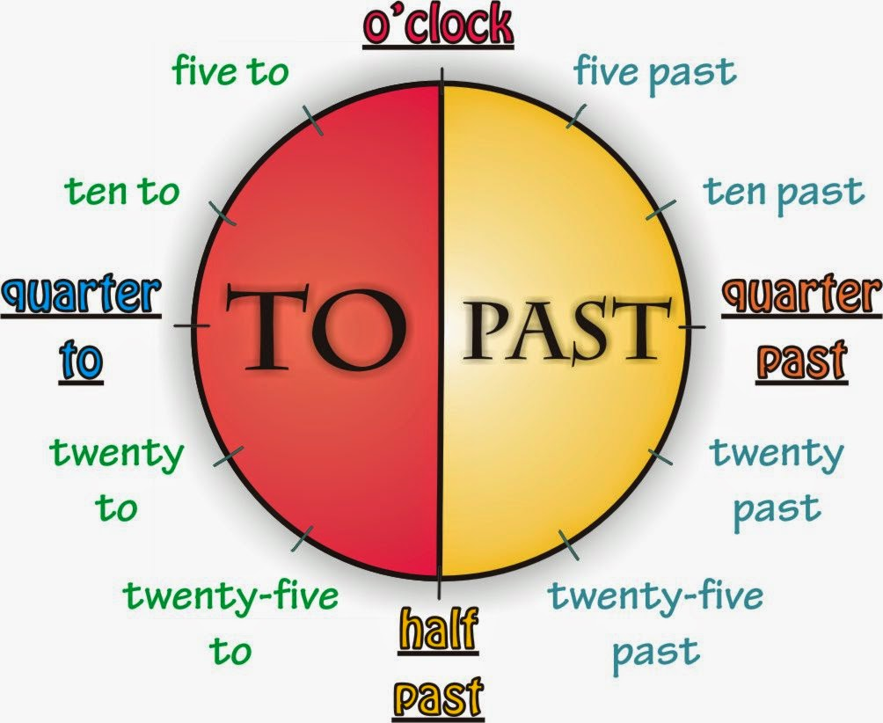
You can practice on telling the time!

Slide 9
Images courtesy of:
letspractiseblog.blogspot.com/2015/05/telling-time.html
https://www.purposegames.com/game/telling-the-time-in-greek-game

