Slide 1

“ Around the world”
In this lesson I will…
Learn names of countries and nationalities (the names of the people who come from these countries)
Become familiar with the flags of these countries
Play a memory game
Meet people from around the world
Watch a video
Write a post card

Slide 2
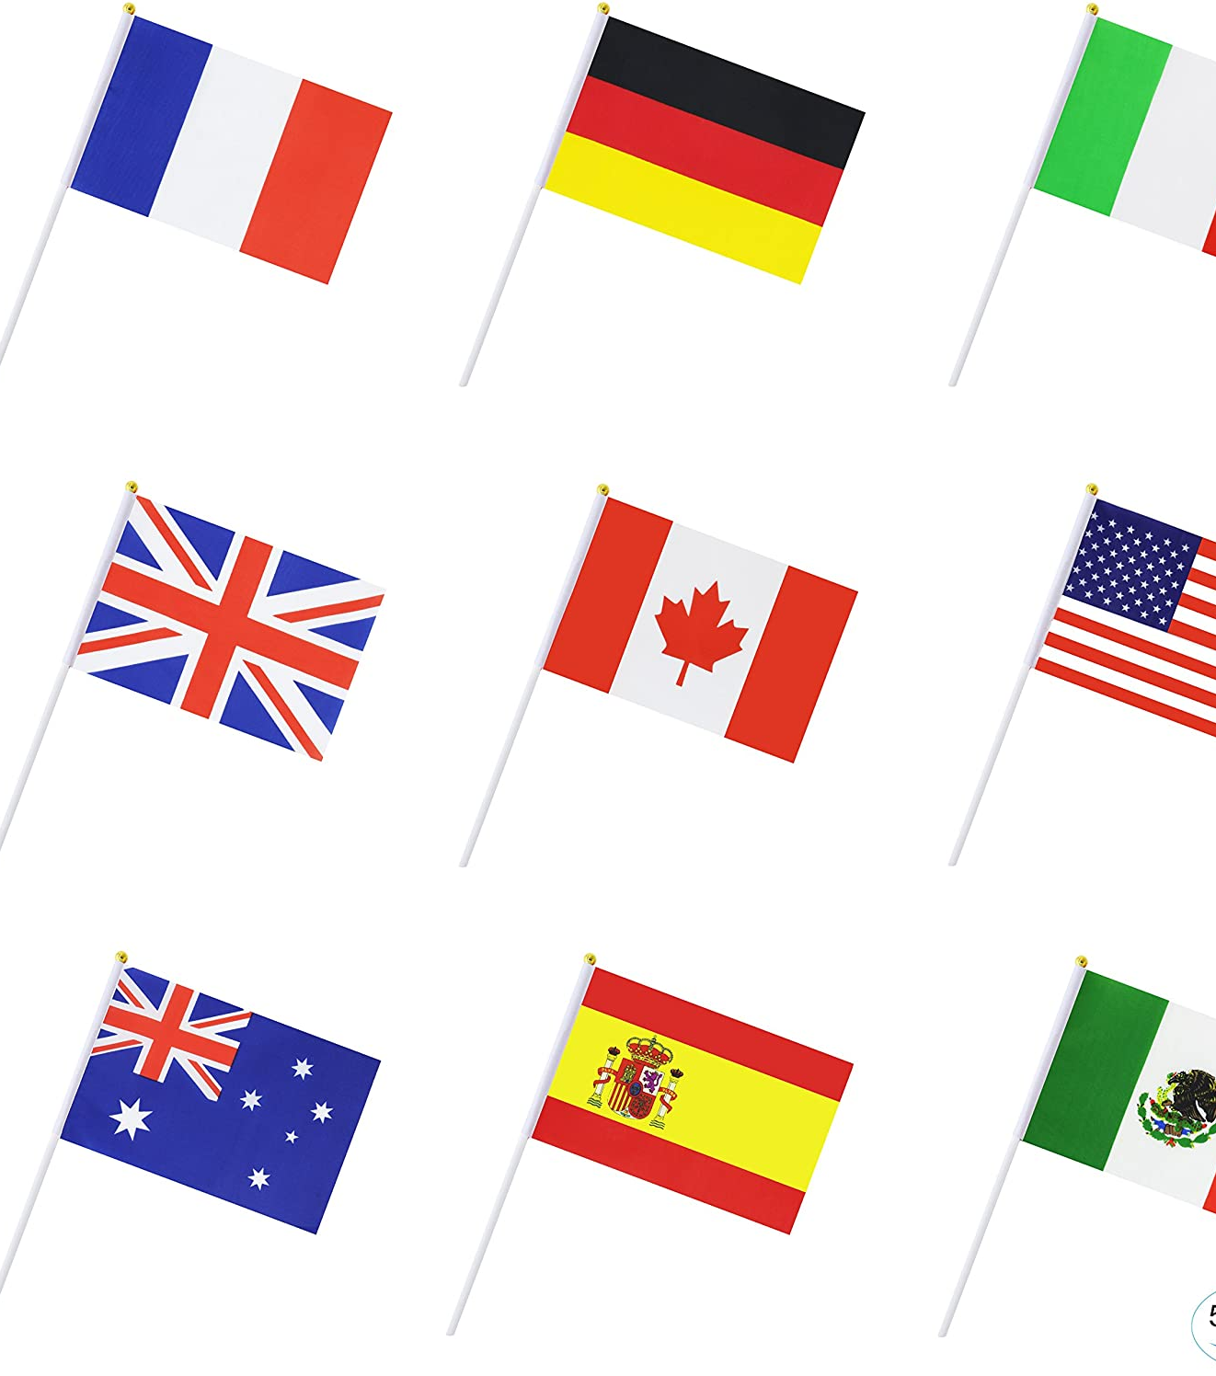
LOOK, READ AND LEARN
Read about the following famous people. Then you will play a memory game about their countries and nationalities

Slide 3

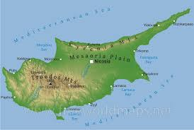

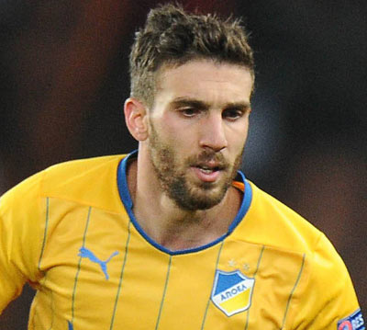
The Cypriot flag
Country: CYPRUS
Hi! I’m George Efrem. I am from Cyprus. I am Cypriot!

Slide 4
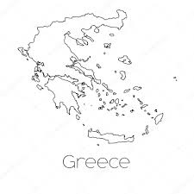

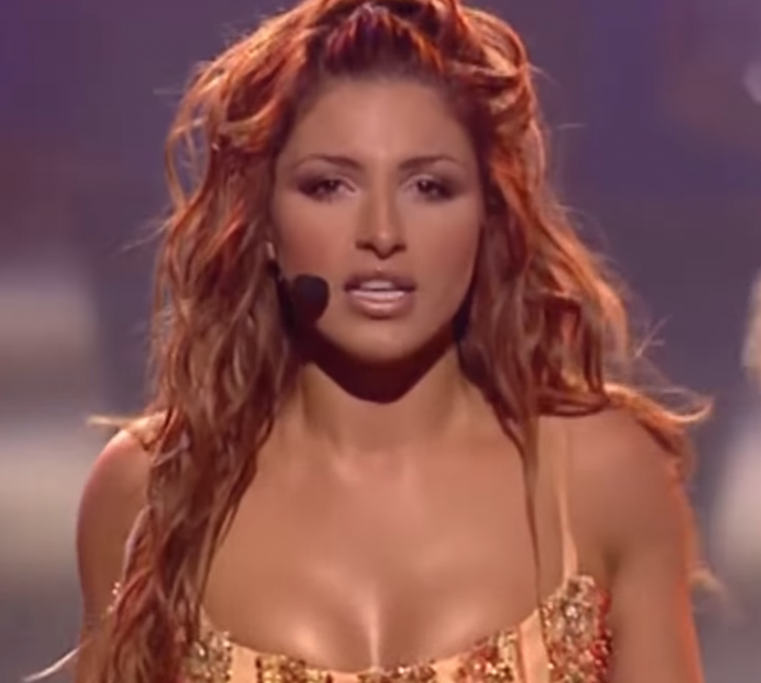
The Greek flag
Country: Greece
Hi! I’m Elena Paparizou. I am from Greece. I speak Greek!

Slide 5
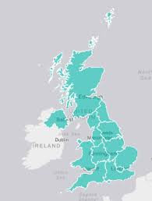

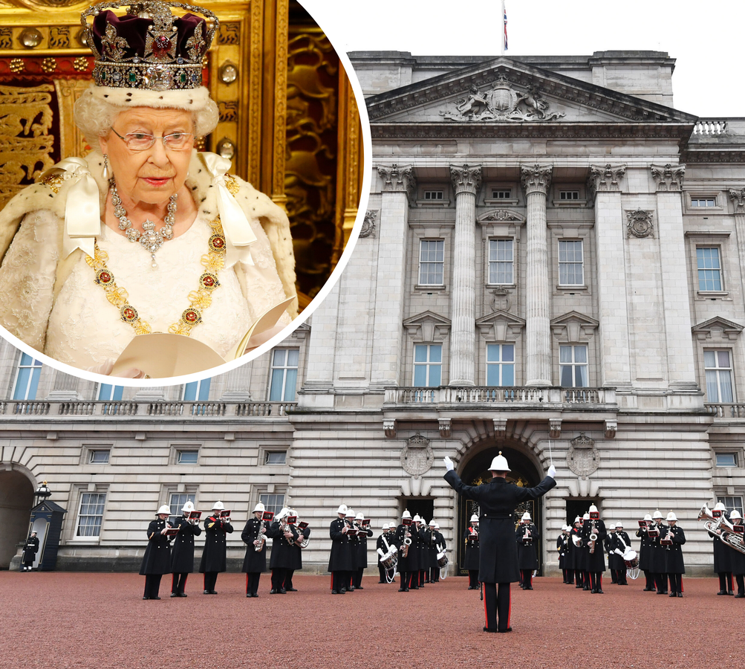
The British flag
Country: Britain
Hi! I am Elizabeth, the British queen. I am from Britain and this is the British Palace.

Slide 6

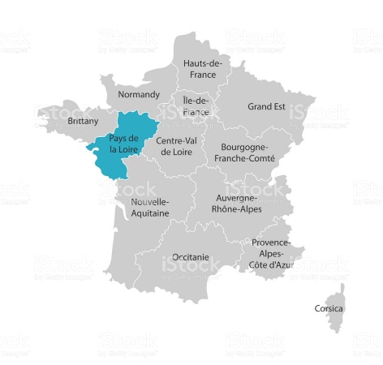
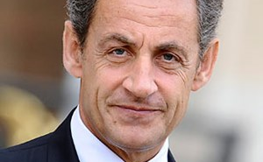
The French flag
Country: France
Hi! I am Nicolas Sarkozy. I am from France .My favourite French football team is Paris Saint Germain.

Slide 7
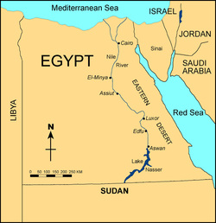

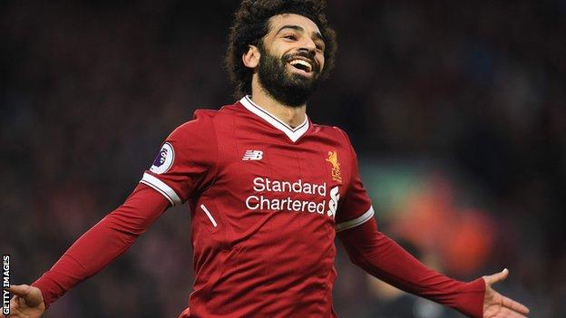
The Egyptian flag
Country: Egypt
Hi! I am Mohamed Salah. I am Egyptian. I am a football player in Egypt.

Slide 8
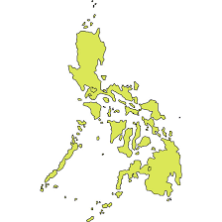
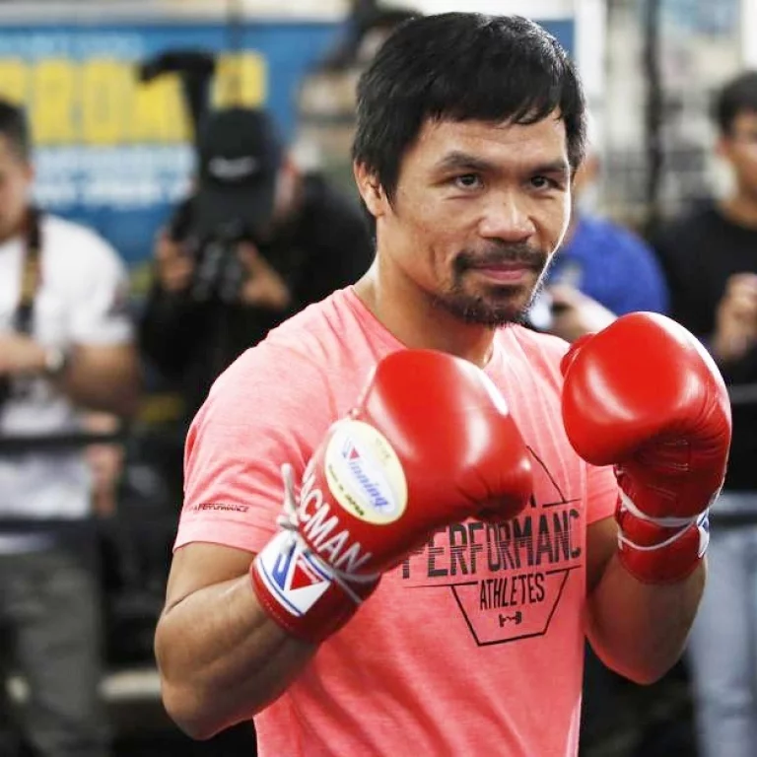
The Filippino flag
Country: The Philippines
Hi! I’m Manny Pacquiao. I am from the Philippines and I am a famous Filippino boxer.

Slide 9
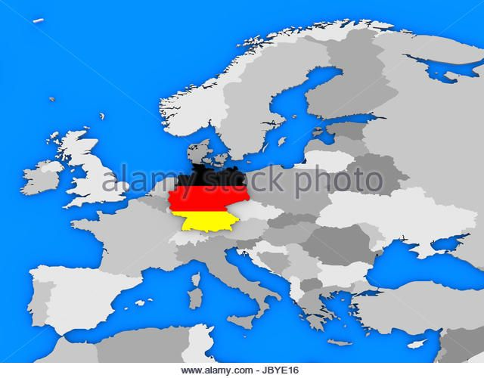

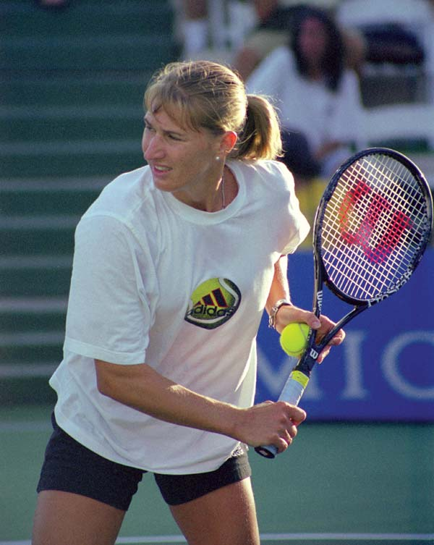
The German flag
Country: Germany
Hi! I am Steffi Graf, a German tennis player!
I live in Germany.

Slide 10
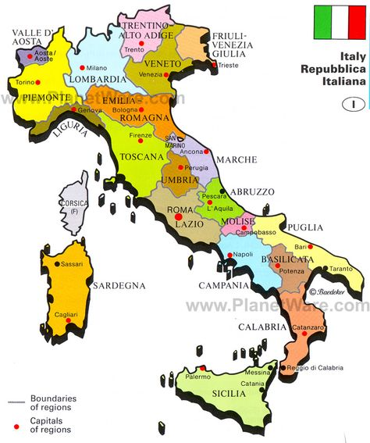

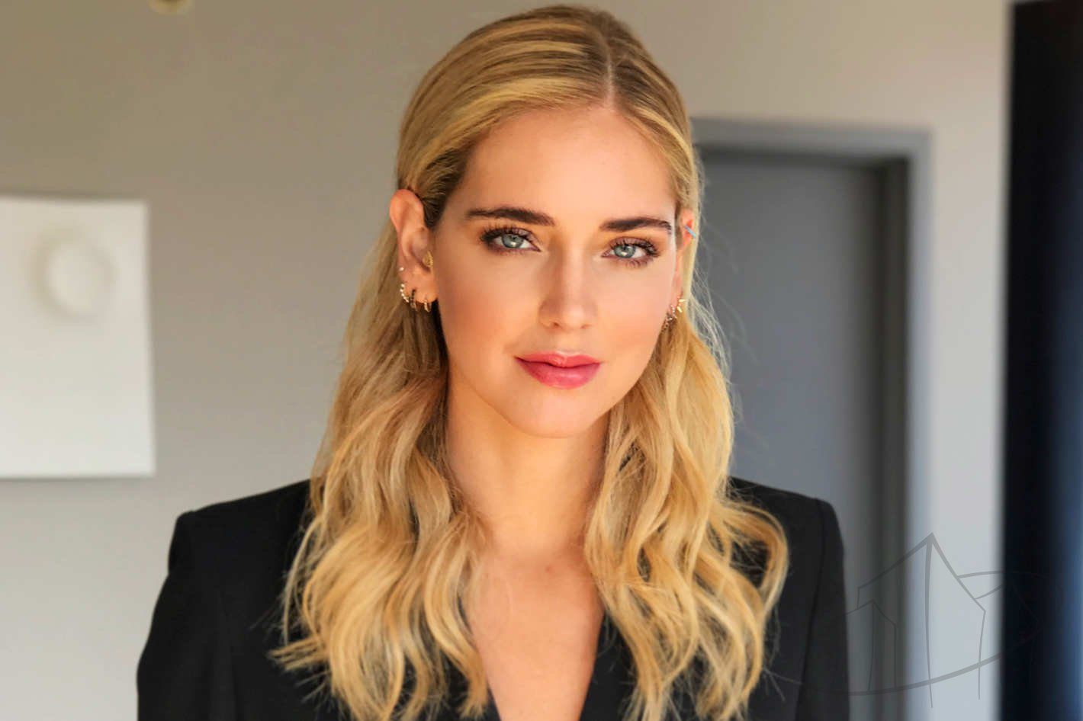
The Italian flag
Country: Italy
Hi! I am Chiara Ferragni, a fashion designer from Italy. I love Italian fashion. I live in Milan, Italy.

Slide 11
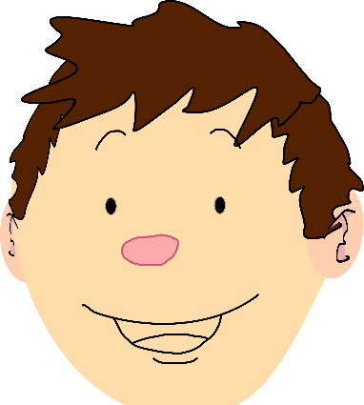
Now, do you remember their country or nationality? Play this memory game:
https://wordwall.net/resource/569199
Good luck!!!

Slide 12
LET’S PLAY...
Have fun!!!
Click on the link to play this CONCENTRATION game:
https://www.quia.com/cc/3111771.html
Clink on the link to play this memory game:
https://www.eslgamesplus.com/countries-esl-vocabulary-memory-game-with-flags-low/
Click on the link to play this spelling game:
https://www.eslgamesplus.com/countries-nationalities-esl-interactive-spelling-activity-online/
HELP : Go back at the LOOK,READ AND LEARN if you need help!

Slide 13
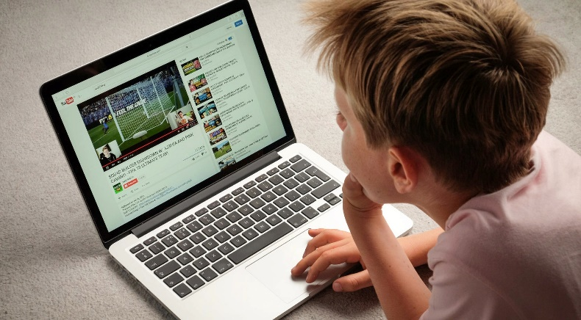
LET’S WATCH A VIDEO…
Now you are going to watch a VIDEO about two friends who come from different countries
Watch the video about Nawwar and Alec :
https://youtu.be/XrHHJIQ5fy8

Slide 14
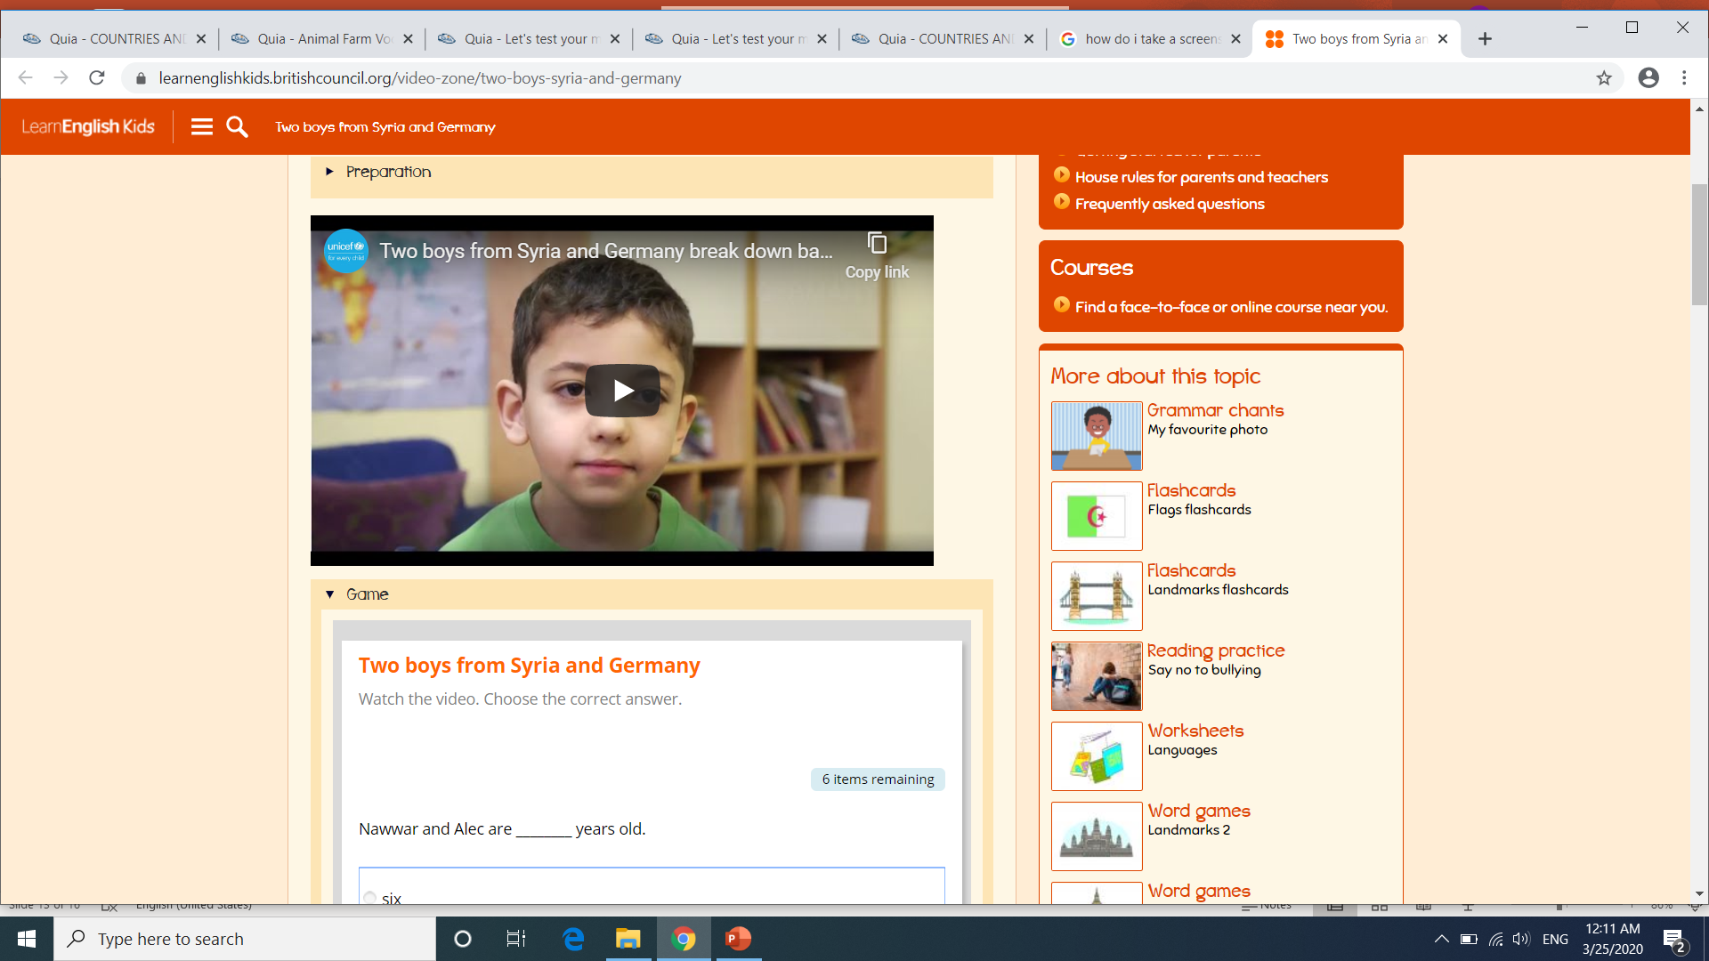
Now do the activity by clicking the link below:
https://learnenglishkids.britishcouncil.org/video-zone/two-boys-syria-and-germany

Slide 15
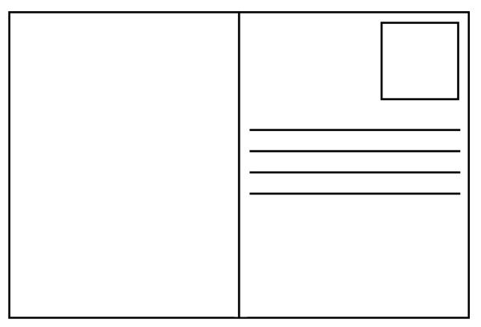
LET’S BE CREATIVE
This is a postcard from Alec. Can you write a postcard to Nawwar or Alec?
Dear Maria
I am Alec and I am from Germany. I live in Berlin and I am seven years old. In my school there are many children from other countries like Syria, Poland and Austria. My best friend is Nawwar and he is Syrian. In Germany we love German sausages! My favourite Italian football team is Barcelona. What about you? How is your school in Cyprus?
Write to me about your country.
Love,
Alec
Alec
2,Springerstreet
Berlin
Germany

Slide 16
Write your postcard in your exercise book or on a piece of paper
…………………………………………………………………………………………………………………………………………………………………………………………………………………………………………………………………………………………………………………………………………………………………………………………………………………………………………………………………………………………………………………………………………………………………………………………………………………………………………………………………………………………………………………………………………………………………………………………………………………………………………….

Slide 17

Did you enjoy the lesson today?

Slide 18
Presentation designed by the English Curriculum Development team,
Cyprus Ministry of Education and Culture

