Slide 1
Days of the week
D class

Slide 2
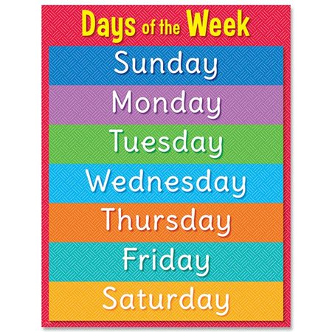
Read the days of the week
https://www.walmart.ca/en/ip/Creative-Teaching-Press-CTP8613-Days-of-the-Week-Chart/PRD53562TF5KHLJ

Slide 3
You can write the days of the week in your exercise book three times each.

Slide 4
Find the seven days of the week
https://crayonsandcravings.com/days-word-search/

Slide 5
I can watch on the web
Week days and colours
http://cybc.com.cy/video-on-demand/episodes/μένω-σπίτι-και-μαθαίνω-απο-τη-τηλεορασ-5/

