Slide 1
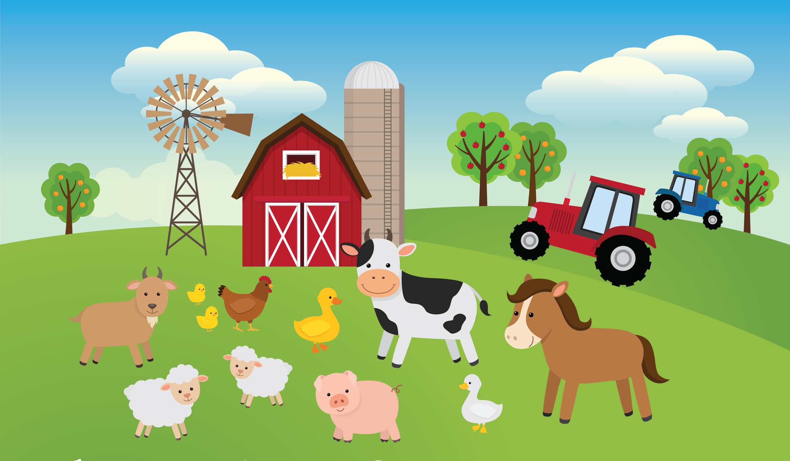
The farm animals
What is this? This is a …

Slide 2
What is this?
This is a cat.

Slide 3
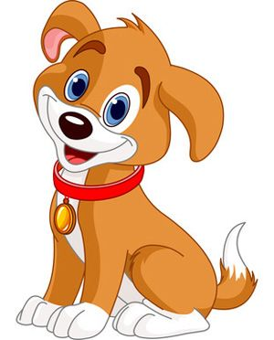
What is this?
This is a dog.

Slide 4
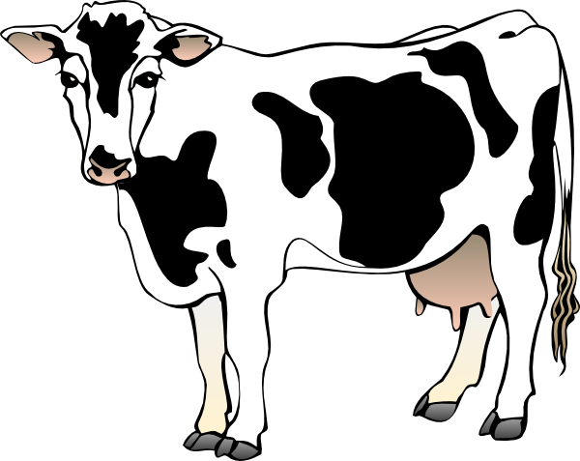
What is this?
This is a cow.

Slide 5
What is this?
This is a horse.

Slide 6
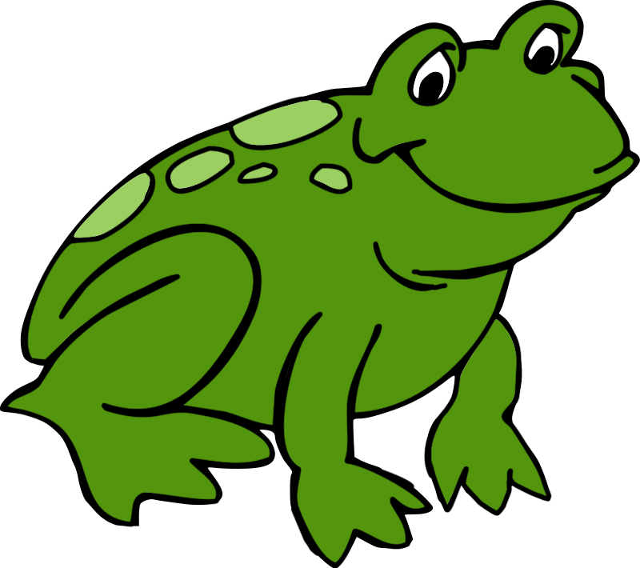
What is this?
This is a frog.

Slide 7
What is this?
This is a duck.

Slide 8
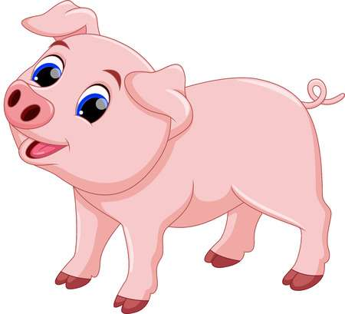
What is this?
This is a pig.

Slide 9
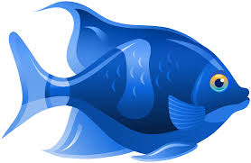
What is this?
This is a fish.

Slide 10
Well done!

